Slide 1


Applying Predictive Analytics on Overwatch Mouse Settings dataset
BDM500 Fall 2022
12/8/2022
By: Jeff Sit

Slide 2


Slide 3
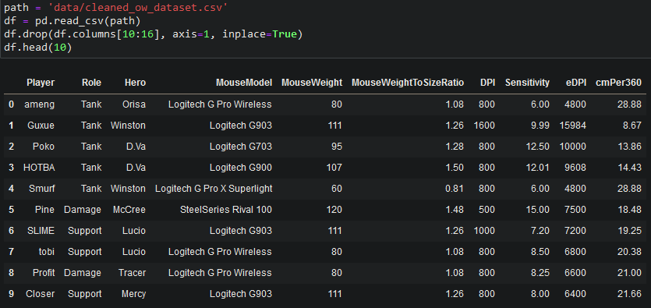
Looking at the data

Slide 4

Business Questions

Slide 5

What are the best mouse settings to use in Overwatch? If there is no best, why not?

Slide 6

What is the relationship between Role and cmPer360? Can either be predicted based on the other?

Slide 7
Potential issues
Not enough information, especially when split into train/test sets (only 148 rows!)
Some players may prioritize comfort over all else
Might use an older, heavier, technologically and physically inferior mouse because of a comfortable shape

Slide 8
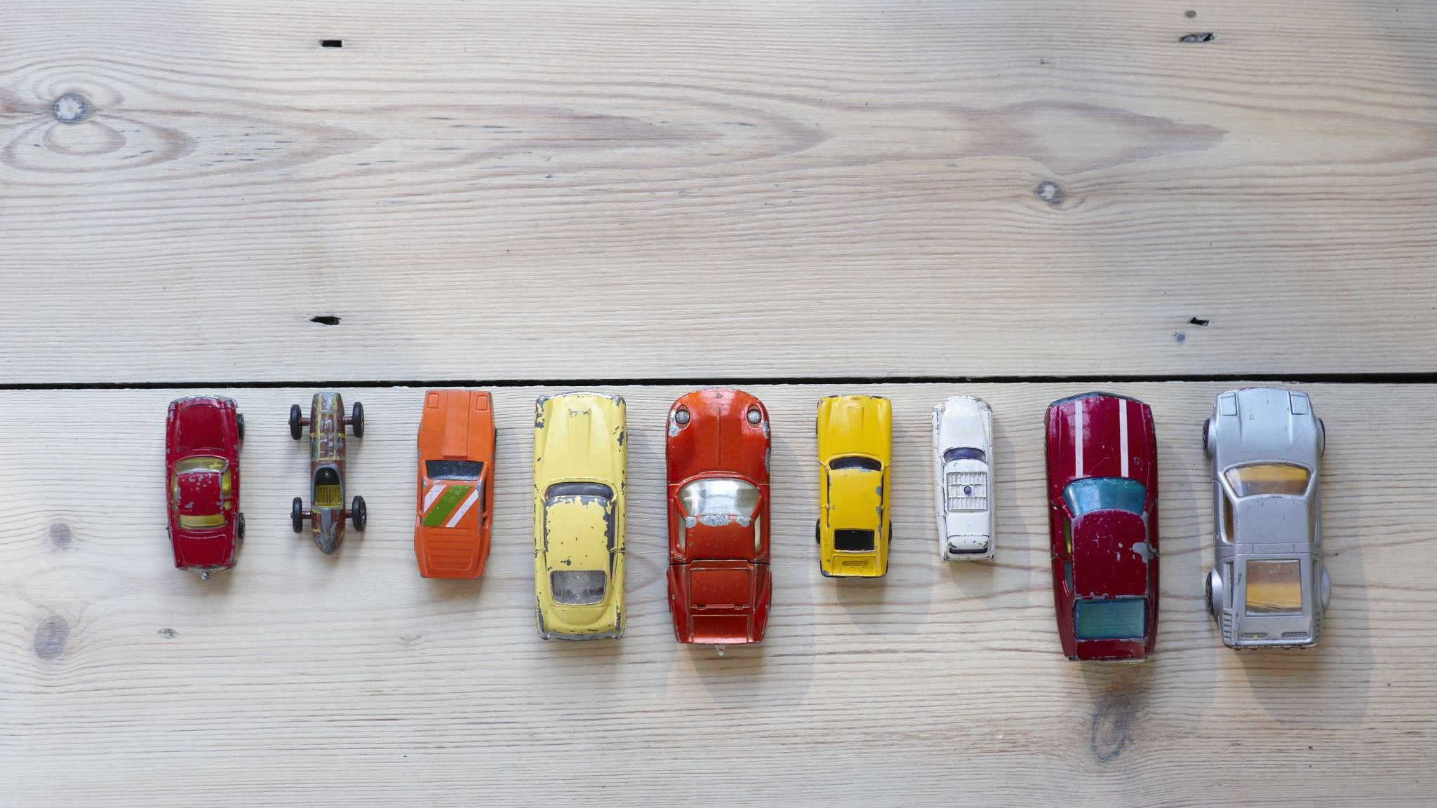
Data Preprocessing, Visualizations, & Models

Slide 9
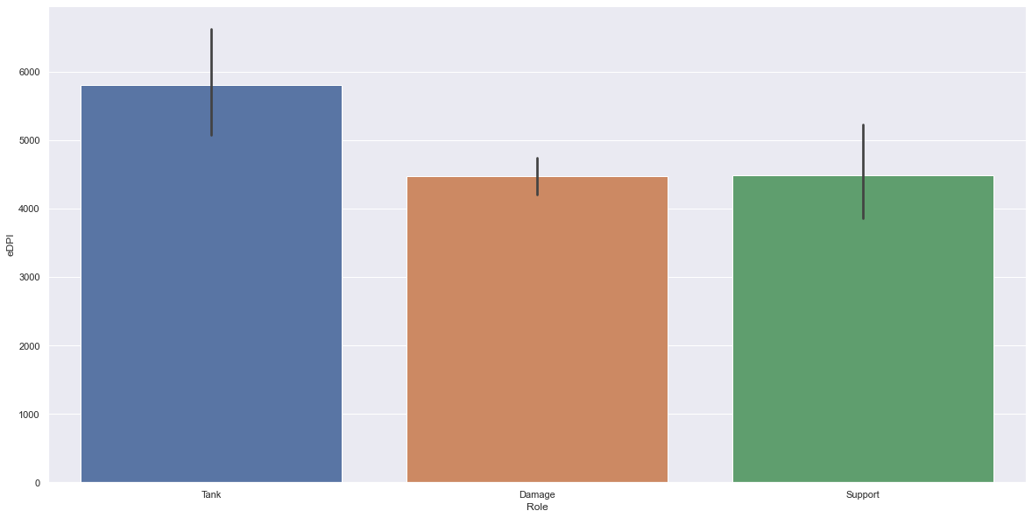

Slide 10
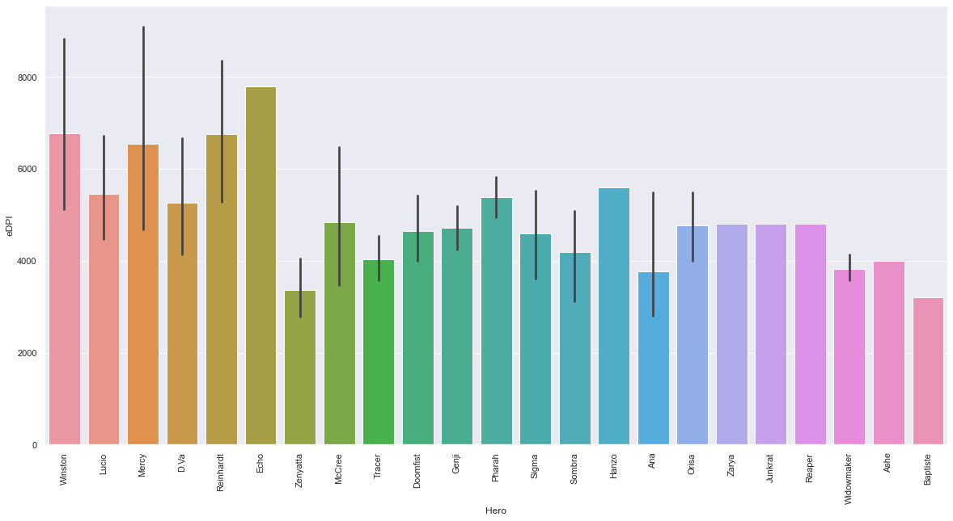

Slide 11
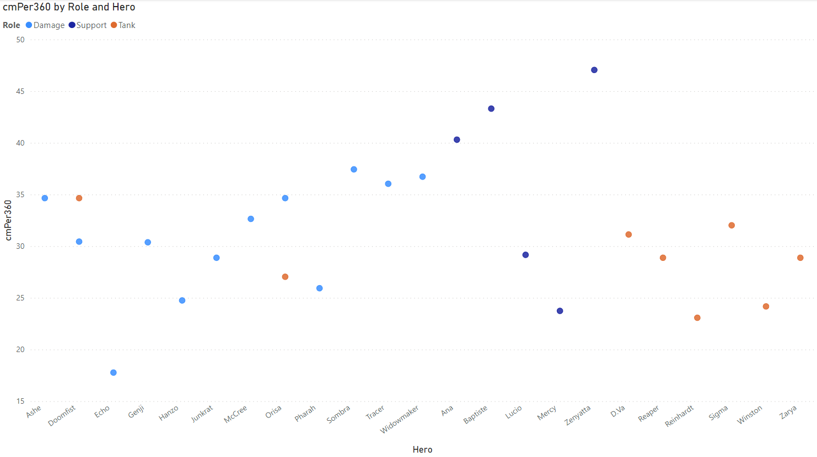

Slide 12
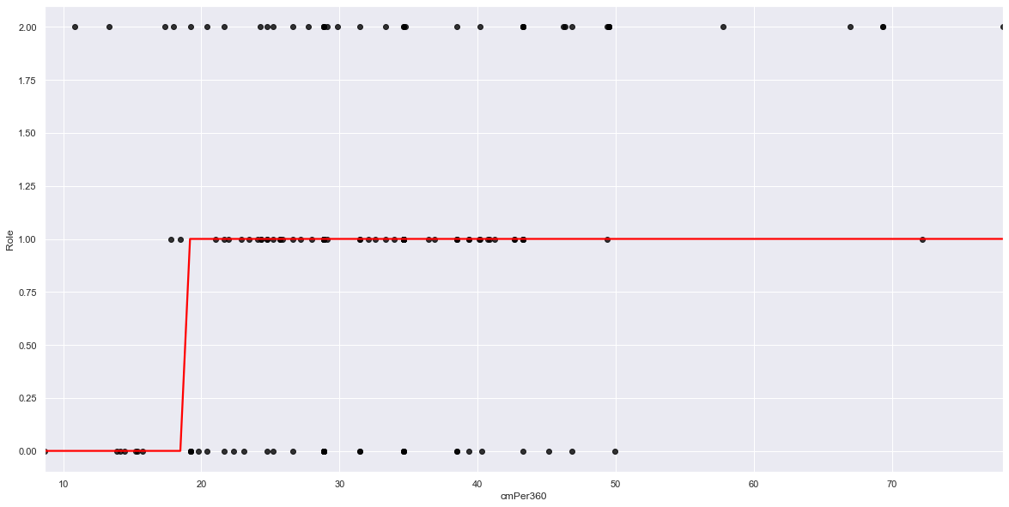
Logistic Regression Visualization

Slide 13

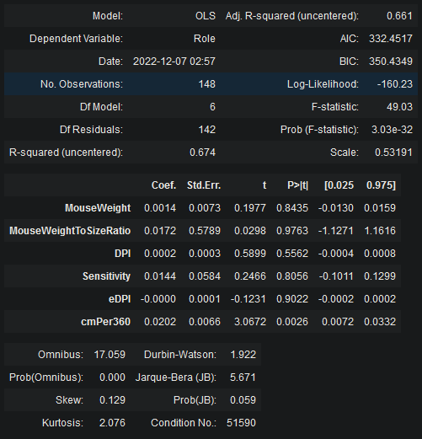
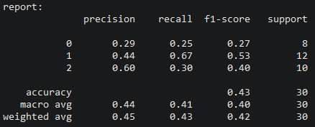
Metric Evaluation
Classification report
Stats model summary

Slide 14
Overall Findings
No such thing as “best mouse settings”, use what is comfortable and get accustomed to it
Role cannot be accurately predicted based on any combination of variables using this logistic regression model
Not enough data in dataset → large reason this model fails

